Slide 1
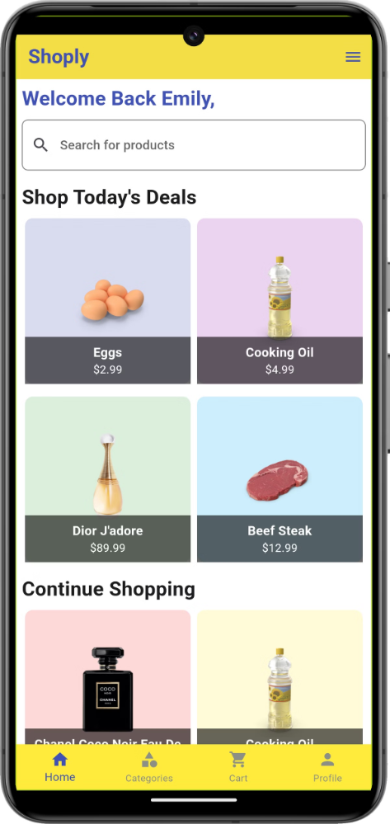

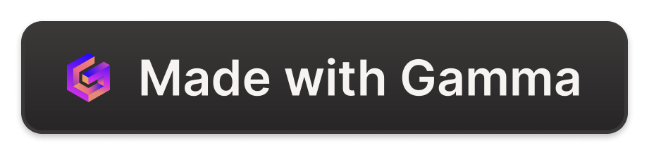
Introduction to the Flutter Ecommerce App
This presentation will provide an overview of a robust Flutter-based ecommerce app. We'll explore the project scope, the technologies used, the UI/UX design process, the key features and functionalities, and the state management approach leveraging the Provider package.
by Esraa Salah

Slide 2
Project Overview
Scope
Technologies
Dummy API
The ecommerce app will allow users to browse products, add them to a cart, and complete purchases. It will have a clean and intuitive interface, with a focus on providing a seamless shopping experience.
The app is built using the Flutter framework, which enables cross-platform development. It utilizes Dart as the programming language and the Provider package for state management.
The app integrates with a dummy JSON API to fetch product data, allowing for a realistic shopping experience without the need for a backend server.

Slide 3
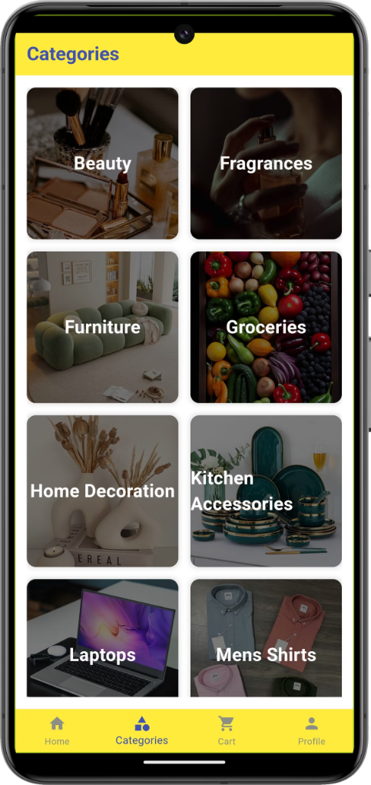
UI/UX Design
1
Design Tools
The UI/UX design was created using Figma, a popular design tool that enables collaborative work and seamless integration with the development process.
2
Design Principles
The app follows Material Design guidelines, ensuring a consistent and intuitive user experience across all screens.
3
Responsive Design
The app is designed to be responsive and adaptable to different screen sizes, providing an optimal experience on both mobile and tablet devices.
4
Prototyping
Clickable prototypes were created in Figma to validate the user flows and gather feedback from stakeholders and users.

Slide 4
Features and Functionalities
Authentication
Navigation
Home Screen
The app includes an authentication system, allowing users to sign up, log in, and manage their accounts securely.
The app provides a intuitive navigation structure, with a bottom navigation bar and easy-to-use product categories and search functionality.
The home screen features a carousel of featured products, popular categories, and personalized recommendations based on user browsing history.

Slide 5
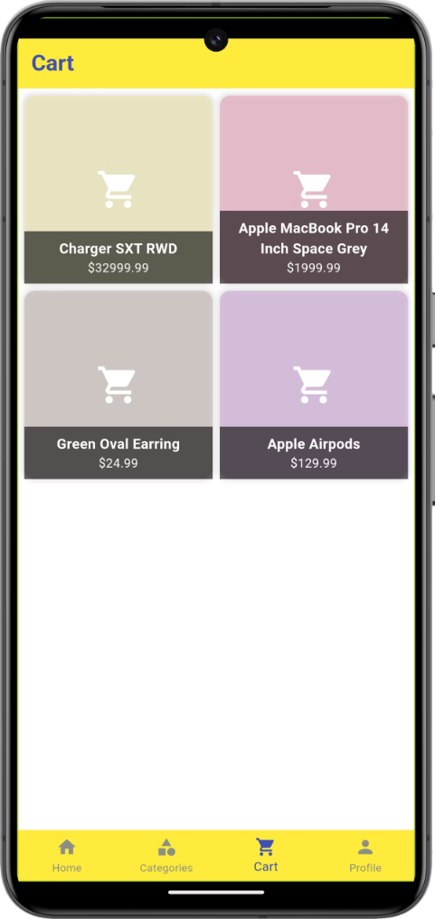
State Management with Provider
1
API Integration
The app integrates with a dummy JSON API to fetch product data, ensuring a realistic shopping experience.
2
State Management
The Provider package is used to manage the app's state, providing a scalable and maintainable solution.
3
Data Storage
The app utilizes local storage to persist user data, such as the shopping cart and order history, even when the app is closed.

Slide 6
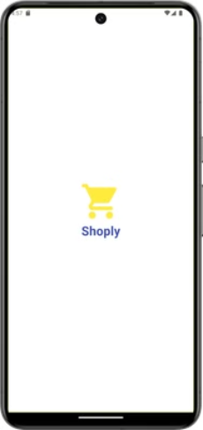
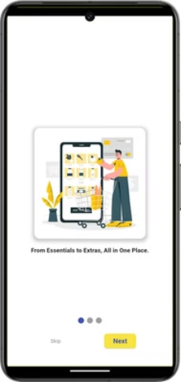
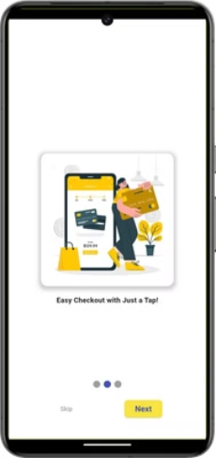
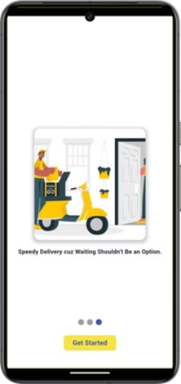
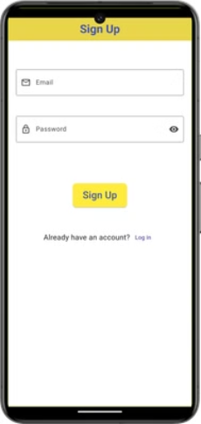
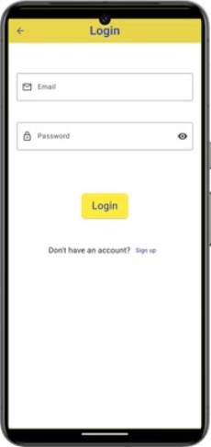
App Screens

Slide 7
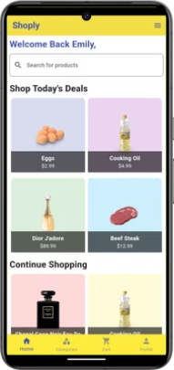
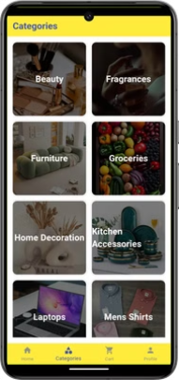
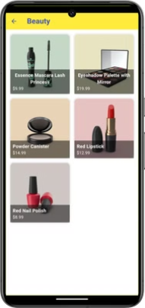

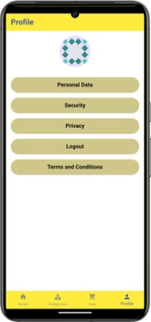
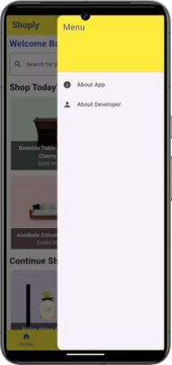
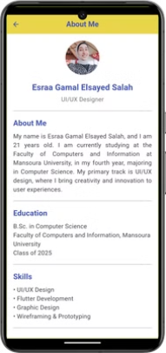
Cont.

Slide 8


Demo URL
Flutter Proj Demo.mp4

Slide 9

GitHub Repository URL
Esraa-G/Shoply_App (github.com)

Slide 10

Thank You!🐥

